Slide 1


Team TBD
Zach Madison, Solomon Preston,
Alex Peters, and Adonis Lattimore.
Artist: Joshua Sykes

Slide 2
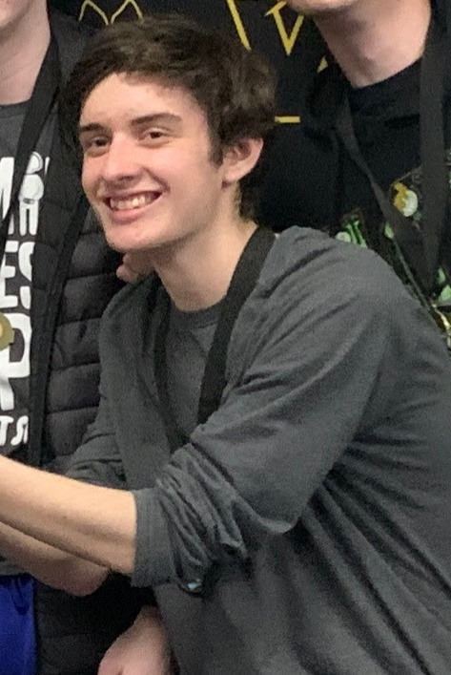
New Member
Brought on Joshua Sykes as an artist

Slide 3
Week Two Iteration Goals
A stage for the user to play
Hazards for the player to avoid
Animated player character
Moving Camera

Slide 4
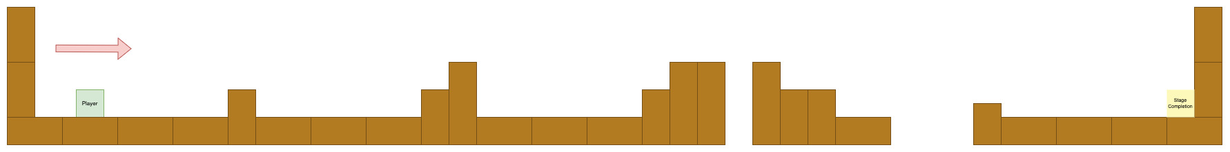
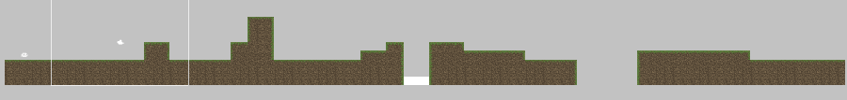
Stage Design/Implementation

Slide 5
Completed Iteration Two
Stage one design completed
Stage one created in unity
Camera follows player
Player character animations added
Troubleshooting
Player movement and physics improved

Slide 6
Team TBD
Demonstration

